Slide 1
St. John the Evangelist
His festival – on the 3rd day of Christmas

Slide 2
Unnamed “disciple whom Jesus loved”
Known as:
John the Evangelist (also John the Theologian or John the Divine or John of Patmos, or John the Presbyter.)
He is thought to have authored the Gospel of John, and other Johannine works in the New Testament — the three Epistles of John and the Book of Revelation
The authorship of the Johannine works has been debated by scholars since at least the 2nd century AD.

Slide 3
St. John the Evangelist
Christian tradition says that St. John the Evangelist was one of Christ’s original 12 apostles.
The only one to live into old age and not killed for his faith.

Slide 4
Originally observed on December 21 or 22
He wrote of love, faith, charity, forgiveness, brotherhood and the need of spreading the message of Jesus.
Historians believe that only after 1717, when the Mother Grand Lodge was formed, did Freemasons generally hold festival meetings on either or both June 24 and December 27.

Slide 5
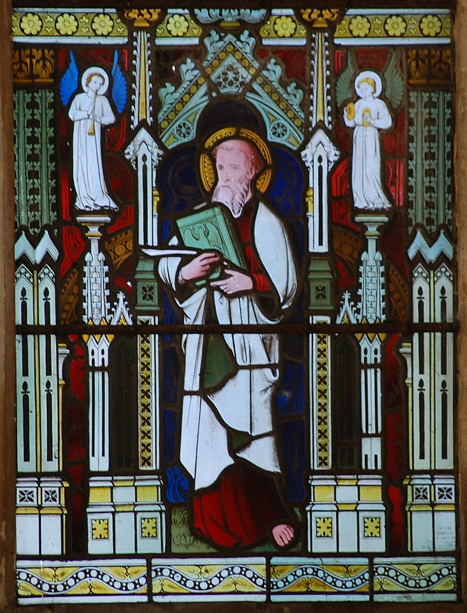
John the Evangelist
The Evangelist is particularly associated with Scottish lodges.
The Lodge of Edinburgh was associated with the aisle of St. John the Evangelist in St. Giles Cathedral from the 15th century.

Slide 6
St. John the Evangelist Day
The Grand Lodge of All England, and its predecessor, the Ancient Society of Freemasons in the City of York, elected and installed their president on St. John’s Day;
then from 1725 their Grand Master on the day of the Evangelist, and in London, the Antient Grand Lodge of England elected their new Grand Masters on the same day.

Slide 7
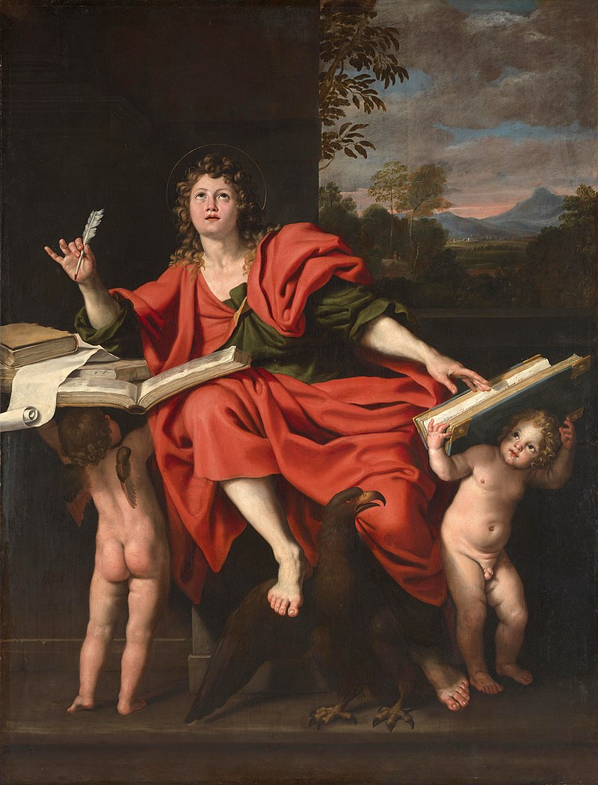
John the Evangelist
When the Antients and the Moderns (the Premier Grand Lodge) eventually came together in the United Grand Lodge of England, it was on the Feast of the Evangelist on December 27, 1813.

Slide 8
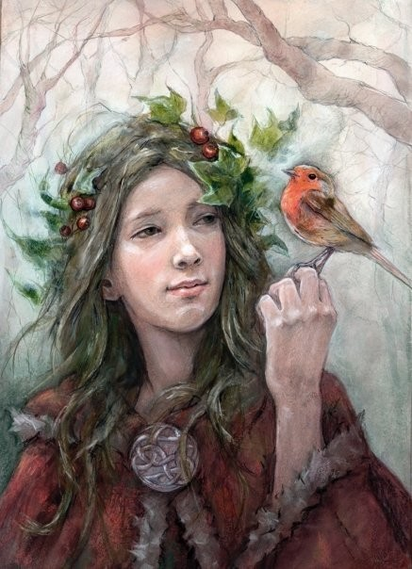
An Important Celebration
In medieval times, December 27th marked the winter solstice or shortest day of the year.
It was an extremely important high feast day as communities were not certain of living through the winter!

Slide 9
Eat, drink and be merry!
Starvation was common in winter between January and April, also known as "the famine months".
In temperate climates, the midwinter festival was the last feast celebration, before deep winter began.

Slide 10
It was the beginning of the new year
The medievals only recognized two seasons, winter and summer, the shortest day of the year and the longest day of the year.
They were pagan in nature – massive eating, drinking, dancing, gambling, all sorts of vice.

Slide 11
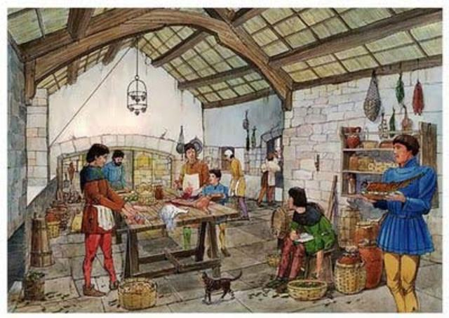
It was the rebirth of the sun
Eat, drink and by merry for tomorrow we may die!
Winter (the wet time) was also considered to be the rebirth of the sun.

Slide 12
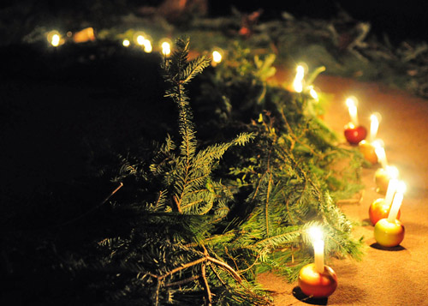
Tradition evolved
As part of the celebration of the rebirth of the sun, the festival involved decorating houses with greenery, lighting candles, holding processions, giving presents.

Slide 13
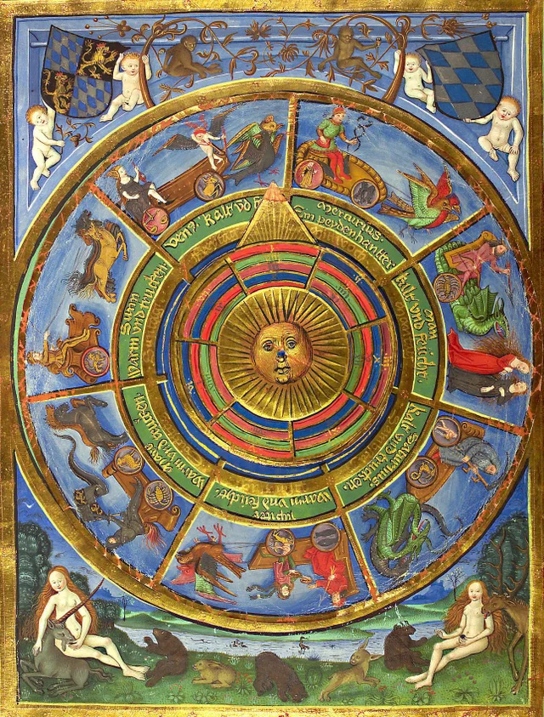
Old traditions die hard
In an attempt to do away with pagan observances, the early church attempted to substitute religious observances instead.

Slide 14
Winter solstice to St. John the Evangelist day
The early church created an eight day festival to begin on December 27th – January 3rd.
The 8 day festival would be abolished by the Pope in 1955 and relegated to one day, December 27th.

Slide 15
Why do we now celebrate on the 27th?
Because of The Christian Church Calendar!
The Christian Calendar recognizes the celebration of the Birth of Christ for 12 days – the 12 days of Christmas,
It begins on December 25th and concludes on the night before Epiphany, on January 6th.
Each of the 12 days has a special celebration for each day.

Slide 16
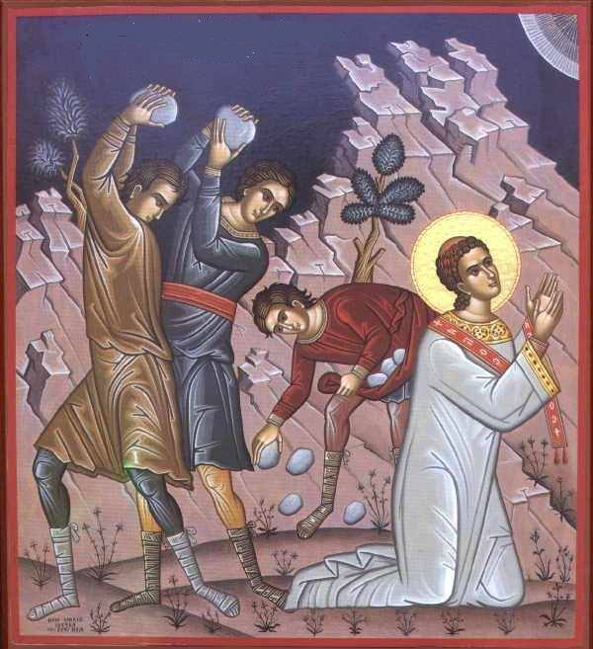
The 12 days of Christmas
Day 1 (25th December): Christmas Day - celebrating the Birth of Jesus;
Day 2 (26th December also known as Boxing Day): Feast of St Stephen’s Day. He was the first Christian martyr; It's also the day when the Christmas Carol 'Good King Wenceslas' takes place. Normally, food is given to the poor.

Slide 17
The 12 days of Christmas
Day 3 (27th December): Festival of St John the Evangelist (One of Jesus's Disciples and friends) – a feast day.
Traditional Punch for toasting on St. John’s Day
St. John's Love (serves 8)
1 quart red wine
3 whole cloves
1/16 teaspoon ground cardamom
2 two-inch cinnamon sticks
1/2 teaspoon ground nutmeg
1/2 cup sugar
Pour the wine into a large saucepan. Add the remaining ingredients. Boil for 5 minutes (this pretty much evaporates all of the alcohol). Serve hot, clinking glasses with the toast "Drink the love of St. John!"

Slide 18
The 12 days of Christmas
Day 4 (28th December): The Feast of the Holy Innocents - when people remember the baby boys which King Herod killed when he was trying to find and kill the Baby Jesus.
As to customs, the youngest child "rules the day." It is the youngest who decides the day's foods, drinks, music, entertainments, etc
In Spain and Hispanic countries like Mexico, Childermas is rather like April Fools Day is in America and France. Tricks are pulled, and the one tricked is called "Innocente!" rather than an "April Fool
To recall the blood of the martyrs, a food with a red color, especially a pudding or ice cream with a red sauce, such as raspberry, is traditional.
Day 5 (29th December): In honor of St Thomas Becket. He was Archbishop of Canterbury in the 12th century and was murdered on 29th December 1170 for challenging the King’s authority over Church.
Day 6 (30th December): In honor of St Egwin of Worcester. As a bishop he was known as a protector of orphans and the widowed.

Slide 19
The 12 days of Christmas
Day 7 (31st December): New Years Eve (known as Hogmanay in Scotland). The life of Pope Sylvester I is traditionally celebrated on this day. served as Pope of the Catholic Church from 314 to 335 and oversaw both the First Council of Nicaea and Roman Emperor Constantine's conversion to Christianity.
You are to eat lucky foods at midnight, 12 grapes, pea soup, black eyed peas.
Day 8 (1st January): 1st January - Mary, the Mother of Jesus or Feast of the Circumcision.
Day 9 (2nd January): St. Basil the Great and St. Gregory Nazianzen, two important 4th century Christians.

Slide 20
The 12 days of Christmas
Day 10 (3rd January): Feast of the Holy Name of Jesus. This remembers when Jesus was officially 'named' in the Jewish Temple. It's celebrated by different churches on a wide number of different dates!
Day 11 (4th January): Feast of St. Elizabeth Ann Seton, the first American saint, who lived in the 18th and 19th centuries. In the past it also celebrated the feast of Saint Simon Stylites (who lives on a small platform on the top of a pillar for 37 years!).
Day 12 (5th January also known as Epiphany Eve): St. John Neumann who was the first Bishop in American. He lived in the 19th century. Also known as Twelfth Night
A rich cake of fruit and nuts is baked with a dried pea inside.

Slide 21
Pagan to religious to Masonic day of celebration
It was a common custom in the Middle Ages for craftsmen to place themselves under the protection of some saint of the church.
At least 11 medieval trade guilds selected St. John the Baptist as their patron saint.

Slide 22
Why chosen as one of our patron saints?
In what is called the Old York Lecture from about 1770 in England has the following as part of its EA catechism:
Q. To whom were the lodges dedicated during the Mosaic dispensation?
A. To Moses, the chosen of God, and Solomon, the son of David.
Q. And under what name were the Masons known during that period?
"A. Under the name of Dionysiacs, Geometricians, or Masters in Israel.

Slide 23
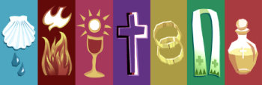
Why chosen as one of our patron saints?
Q. But as Solomon was a Jew, and died long before the promulgation of Christianity, to whom were they dedicated under the Christian dispensation?
A. From Solomon the patronage of Masonry passed to St. John the Baptist.
Q. And under what name were they known after the promulgation of Christianity?
A. Under the name of Essenes, Architects, or Freemasons."

Slide 24
Why chosen as one of our patron saints?
Q. Why were the lodges dedicated to St. John the Baptist?
A. Because he was the forerunner of our Saviour, and by preaching repentance and humiliation, drew the first parallel of the Gospel.
Q. Had St. John the Baptist any equal?
A. He had; St. John the Evangelist.

Slide 25
Why chosen as one of our patron saints?
Q. Why was he said to be the equal of the Baptist?
A. Because he finished by his learning what the other began by his zeal, and thus drew a second line parallel to the former; ever since which time Freemason's lodges in all Christian countries, have been dedicated to the one, or the other, or both of these worthy and worshipful men.

Slide 26
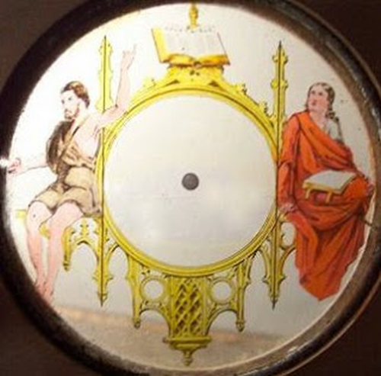
the symbol implies that a Mason should consult the sacred texts of his own religion to achieve the proper balance between passion and intensity on one side, and knowledge and education on the other.
In other words, he should balance education, excitement and faith to effectively subdue his passions. In a way, it is a graphic representation of the conscience.

Slide 27
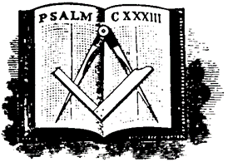

St. John the Evangelist
is recognized the world over as the apostle of love and light,
the bringer:
of comfort to the grief-stricken,
of courage to the weak,
of help to the helpless,
of strength to the falling.

Slide 28
The Gospel of St. John
1:1 In the beginning was the Word, and the Word was with God, and the Word was God.
1:2 The same was in the beginning with God.
1:3 All things were made by him; and without him was not any thing made that was made.
1:4 In him was life; and the life was the light of men.
1:5 And the light shineth in darkness; and the darkness comprehended it not.

Slide 29
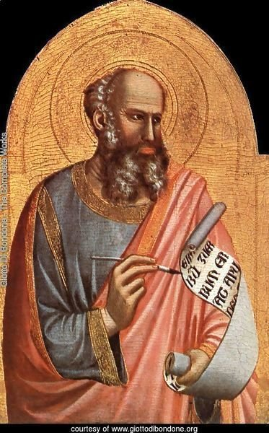
St. John the Evangelist
In his epistles, the Word and the Light are linked and tied to truth and love.
The idea and practice of brotherly love and fellowship is explored more by him than any other New Testament writer.

Slide 30
